Slide 1
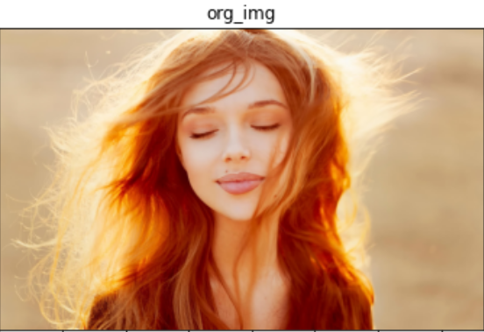
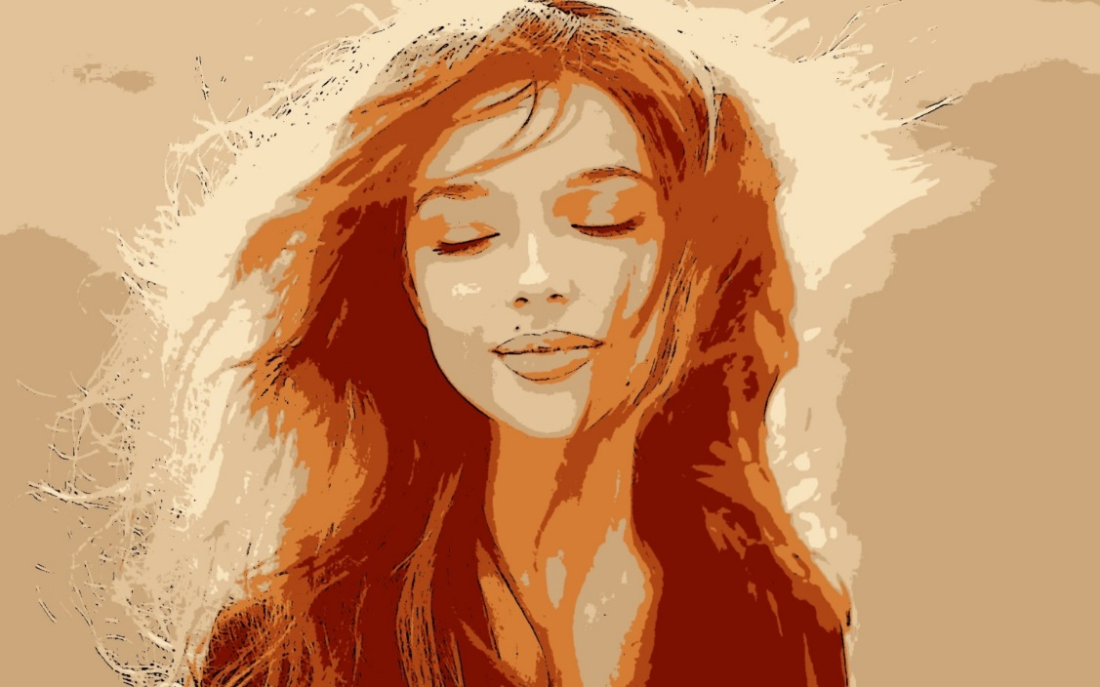
CARTOONIFYING THE IMAGE
RNS INSTITUTE OF TECHNOLOGY
BENGALURU - 98
DEPARTMENT OF COMPUTER SCIENCE & ENGINEERING
Presentation on Internship

Slide 2
AGENDA
Abstract
About the Company
Introduction
Literature Survey
Requirements
System Design
Detailed Design
Implementation
Results
Conclusion and Future Enhancements
References
Q & A

Slide 3
ABSTRACT
Animation pictures assume basic parts in our regular day to day existences particularly in diversion, training, and promotion, that become an inexorably escalated research in the field of media and PC designs .
The naturally animation object extraction is exceptionally helpful in numerous applications; one of the most significantly is the animation pictures recovery.
This project represents different techniques of converting image to cartoon. Using any one of below mentioned techniques it is possible to convert all types of captured images to cartoon such as images of person, mountains, trees, flora and fauna etc.

Slide 4
ABOUT THE COMPANY
NASTECH – New Age Solutions & Technologies
NASTECH is formed with the purpose of bridging the gap between Academia and Industry.
Nastech is one of the leading Global Certification and Training service providers for technical and management programs for educational institutions.
They collaborate with educational institutes to understand their requirements and form a strategy in consultation with all stakeholders to fulfill those by skilling , reskilling and upskilling the students and faculties on new age skills and technologies.
Industry and project oriented student training programs.
Certification programs mapped to Global Certification Exams from Microsoft/EC- Council/Google/AWS/ Adobe).

Slide 5
INTRODUCTION
Social media is extensively used these days. And standing out in this online crowd has always been a first priority on every user’s list on these social media platforms. Be it images, blog posts, artwork, tweets, memes, opinions are used to seek attention of followers or friends to create influence or to connect with them on such social platforms. We aim to provide one such creative solution to their needs, which is applying cartoon like effects to their images.
You can use a photo of your own in a profile image, create an amusing avatar or turn your photo into a cartoon. With a pool of web applications available online, an image conversion to cartoon takes few clicks.
We propose to create a website, which consists of image upload functionality using which the user can upload his image, the uploaded image is then processed by server using Neural style transfer algorithm and the resulting image is presented to the user on the website

Slide 6
LITERATURE SURVEY
Library Cartoons: A Liter oons: A Literature Review of Libr perspective on Library-themed Car y-themed Cartoons, Caricatur oons, Caricatures, and Comics Julia B. Chambers is a MLIS upand-comer at San Jose State University's School of Library and Information Science.
To comprehend contrasting perspectives on past occasions, antiquarians, political theory researchers, and sociologists have examined political and publication kid's shows with topics going from decisions to financial approach to human rights.
However sparse examination has been devoted to kid's shows with library topics. The creator of this paper inspects peer-explored writing regarding the matter of library kid's shows, including verifiable foundation, examination of ongoing subjects, and contentions for advancing library-themed kid's shows, exaggerations, and funnies.

Slide 7
REQUIREMENTS
HARDWARE REQUIREMENTS
Processor : Any Processor above 500 MHz
RAM : 512Mb
Hard Disk : 4 GB
Input device : Standard Keyboard and Mouse
Output device : VGA and High Resolution Monitor
SOFTWARE REQUIREMENTS
Operating system : Windows 10
IDE : Jupyter Notebook /Google Colab
Tools/Technologies : Python, Streamlit, OpenCv, matplotlib ,pytesseract, Numpy library

Slide 8
SYSTEM DESIGN
To convert an image to a cartoon, multiple transformations are done.
Convert the image to a Grayscale image.
The Grayscale image is smoothened(blurred).
Extract the edges in the image.
Reduce color of original image.
Combine edge mask with color quantized image.
This creates a beautiful cartoon image with edges and lightened color of the original image.

Slide 9
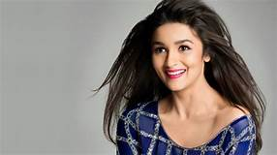
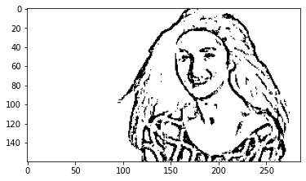
DETAILED DESIGN
Convert image to grey scale and extract edges
gray=cv2.cvtColor(img,cv2.COLOR_RGB2GRAY)
gray_blur = cv2.medianBlur(gray,blur_value)
edges=cv2.adaptiveThreshold(gray_blur,255, cv2.ADAPTIVE_THRESH_MEAN_C,cv2.THRESH_BINARY,line_size,blur_value)
Original Image
Edge Mask

Slide 10
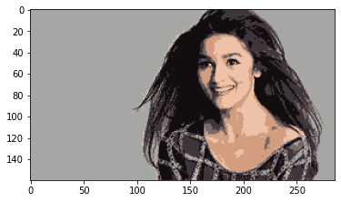
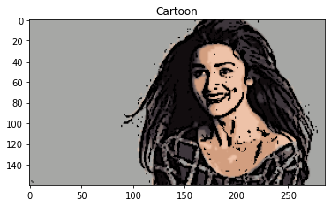
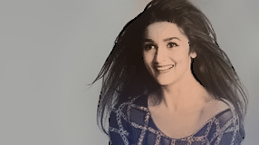
DETAILED DESIGN
Colour-quantized
2. Reduce colour of original image :
#transform img
data=np.float32(img).reshape((-1,3))
#Determine citeria iteration,accuracy
criteria = (cv2.TERM_CRITERIA_EPS+ cv2.TERM_CRITERIA_MAX_ITER, 20 , 0.001) #implementing k-means (clustering)
ret , label , center = cv2.kmeans(data , k,None,criteria,10,cv2.KMEANS_RANDOM_CENTERS)
center = np.uint8(center) result = center[label.flatten()]
result = result.reshape(img.shape)
3. Combine edge mask and quantized image
c = cv2.bitwise_and(blurred,blurred,mask=edges)

Slide 11
IMPLEMENTATION
import numpy as np
import streamlit as st
import pytesseract
from PIL import Image
import cv2
import matplotlib.pyplot as plt
def edge_mask(img,line_size,blur_value):
gray=cv2.cvtColor(img,cv2.COLOR_RGB2GRAY)
gray_blur = cv2.medianBlur(gray,blur_value)
edges=cv2.adaptiveThreshold(gray_blur,255,
cv2.ADAPTIVE_THRESH_MEAN_C,cv2.THRESH_BINARY,line_size,blur_value)
return edges
def color_quantization(img , k ):
#transform img
data=np.float32(img).reshape((-1,3))
#Determine citeria iteration,accuracy
criteria = (cv2.TERM_CRITERIA_EPS+ cv2.TERM_CRITERIA_MAX_ITER, 20 , 0.001)
#implementing k-means (clustering)
ret , label , center = cv2.kmeans(data , k,None,criteria,10,cv2.KMEANS_RANDOM_CENTERS)
center = np.uint8(center)
result = center[label.flatten()]
result = result.reshape(img.shape)
return result

Slide 12
IMPLEMENTATION
def cartoon(blurred,edges):
c = cv2.bitwise_and(blurred,blurred,mask=edges)
return c
def cartoonization(img):
line_size=5
blur_value = st.sidebar.slider('Sharpness of image (the lower the value, the sharper it is)', 1, 99, 25, step=2)
k = st.sidebar.slider('Color averaging effects ', 2, 100,9,step=2)
d = st.sidebar.slider('Smoothness level of the image (the higher the value, the smoother the image)', 3, 99, 3, step=2)
edges=edge_mask(img,line_size,blur_value)
img_quantize=color_quantization(img , k )
blurred = cv2.bilateralFilter(img_quantize,d,sigmaColor=200,sigmaSpace=200)
cc=cartoon(blurred,edges)
return cc
st.set_option('deprecation.showfileUploaderEncoding',False) #to warning ignore
st.title("Cartoonify Images") #print title and text
st.text("Upload the Image")
uploaded_file=st.sidebar.file_uploader("Choose an image...",type=['jpg','png','jpeg'])
if uploaded_file is not None:
img=Image.open(uploaded_file) #reads the image, similar cv2.imread
image=np.array(img)
st.image(image,caption="Uploaded Image",use_column_width=True) #displays the image in its actual size
st.write("") #print blank space
st.write("Cartoon image")
cartoon=cartoonization(image)
st.image(cartoon,caption="Cartooned Image",use_column_width=True)

Slide 13
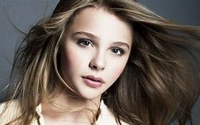
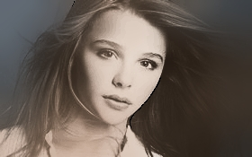
RESULTS

Slide 14
CONCLUSIONS
In this paper, we proposed an image cartoonization web app that transforms real-world photos into high-quality cartoon-style images.
The animation industry is not going to stop now, and the standards are getting higher by the day, so this system provides room for the addition of features and is easily adjustable to any other source code required for larger modules.
Our system can easily be patched up with an automation system and will give expected results image less pixelated.

Slide 15
LIMITATIONS
Training of networks for different style images is time consuming and requires lots of computation hardware(GPUs).
Different content images may produce slightly different styled images.
Precision of cartoon like effect entirely depends on type of content image provided.

Slide 16
FUTURE ENHANCEMENTS
The output is largely dependent on the input and experimented and tested; the system works satisfactorily with almost all images.
There are certain things to improve in our system:
1. The bilateral filter needs improvement. On a good number of images, the filter gives black dots on certain parts of the image.
2. The output of the system currently is completely manual, and input is required by the user. We ought to implement machine learning algorithms to automate some actions in the converting process to get better results.
3. Currently, we have not implemented any download and share options on the cartooonified image.

Slide 17
REFERENCES
[1] Gayatri Deora, Ramakrishna Godhula and Dr. Vishwas Udpikar “Study of Masked Face Detection Approach in Video Analytics”. 2016, IEEE Conference on Advances in Signal Processing.
[2] S. Meivel, K. Indira Devi, S. Uma Maheswari , J. Vijaya Menaka “Real time data analysis of face mask detection and social distance measurement using Matlab”, Dec 2020.
[3] Mingjie Jiang, Xinqi Fan and Hang Yan “Retinal Face Mask Detector”. 9 June 2020, Hong Kong University.
[4] https://docs.opencv.org/3.4/db/d28/tutorial_cascade_classifier.html
[5] https://medium.com/analytics-vidhya/haar-cascades-explained-38210e57970d

Slide 18
Question and Answer

Slide 19
THANK YOU

